Slide 1
jukebox
Music done your way.

Slide 2
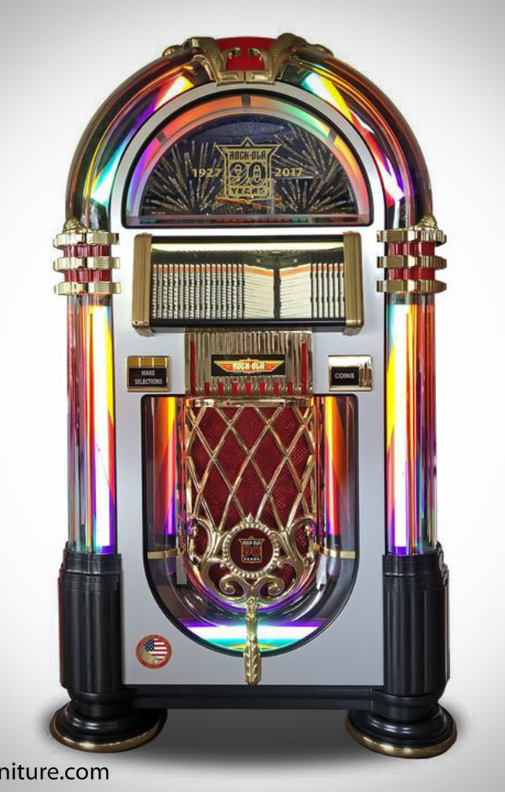
Whats a JukeBox ?
partially automated music-playing device
usually a coin-operated machine
play a patron's selection from self-contained media
In 1918, Hobart C. Niblack patented an apparatus that automatically changed records
leading to one of the first selective jukeboxes being introduced in 1927
Jukeboxes were most popular from the 1940s through the mid-1960s

Slide 3
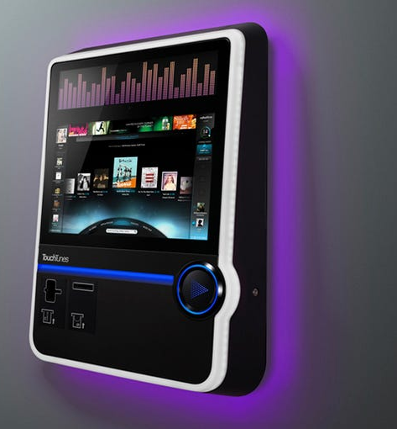
eJukeBox Goals & Vision:
Digital, App based JukeBox Experience
Smart Pay / Vote oriented songs system
1 Host (a bar, a coffee house), Many Clients
Crowd-Controled music.
Songs being picked by votes of the crowd
Music has never been so fun

Slide 4
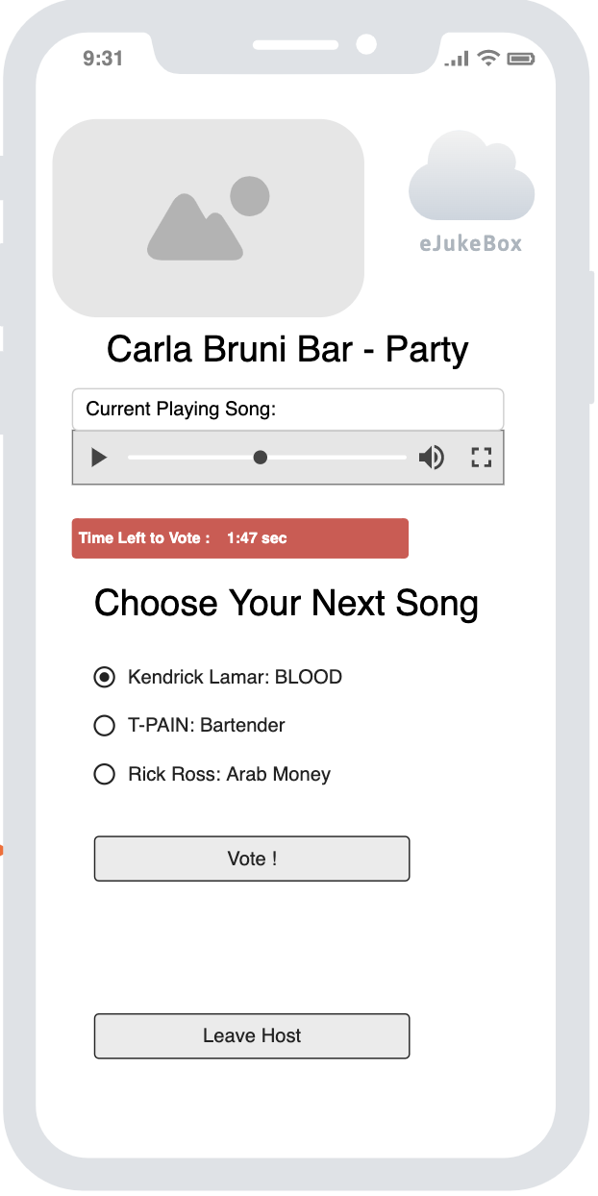
Abstract Vision
Example User Interface

Slide 5
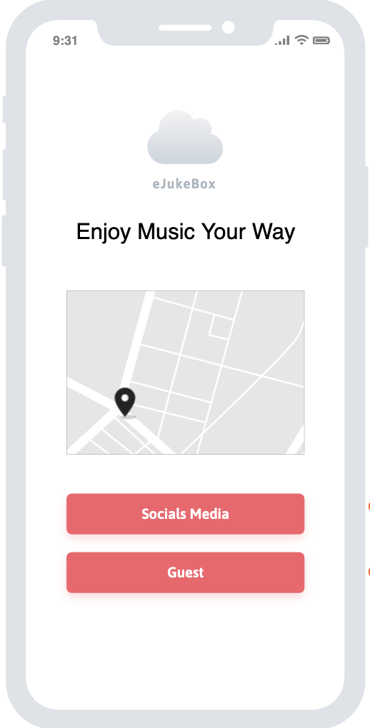
But first, Authentication.
Light, Multi optional and friendly Welcome page.
Via Location – GPS Button.
Via Social Media.
Via Guest Mode.

Slide 6
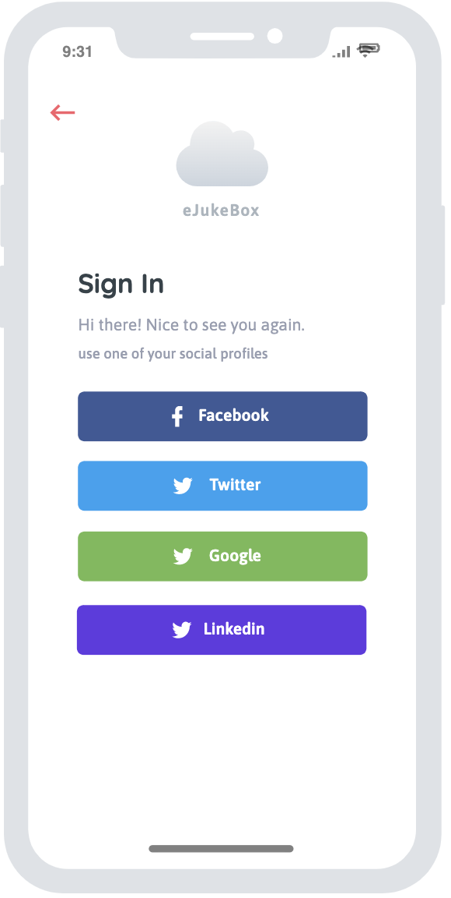
Via Socials Media
Authentication via socials media
Facebook/Google/Twitter/Linkedin
Only Social Media registration for now

Slide 7
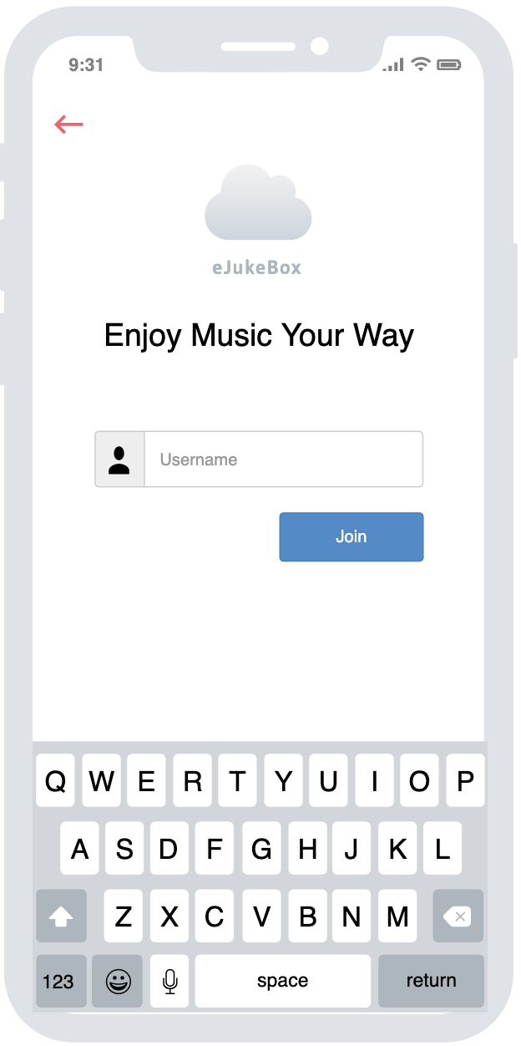
Guest Mode
Just Enter your nickname.
Nickname will be per session
Anonymous use
Pop up for Guest Mode second thoughts confirmation (‘You are about to enter as guest, thus will not enjoy so many awesome features! Are you sure?)

Slide 8
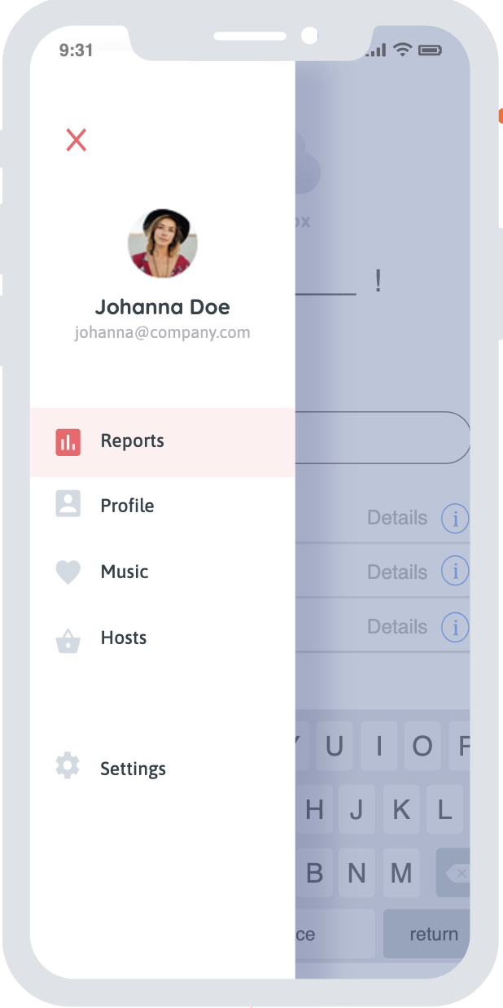
Benefits of signed users:
Users will enjoy extra features :
- Profile page
- Reports (Statistics about user’s app usage)
- Favorites (Artists & Hosts)
- Personalized Suggestions
Hosts could get information about user’s specification that will help them configure music to the user’s taste.
Users could take part of user’s only future activities such as: Suggest Music, Win Prizes and more.

Slide 9
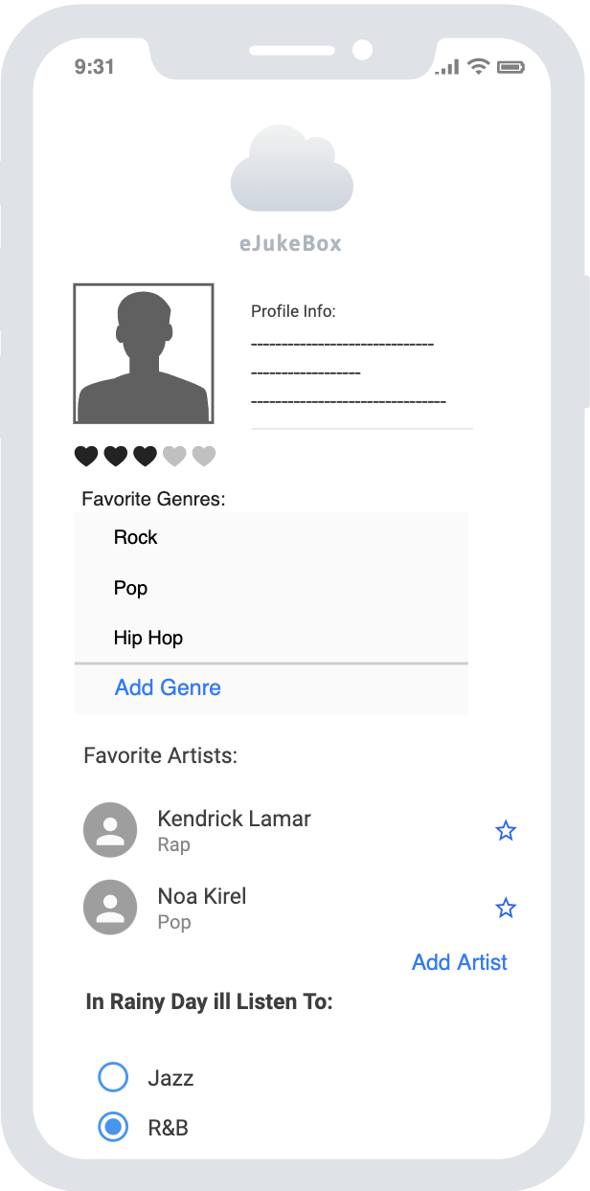
and some more:
Adding / Removing personal data
Genre's personalization
Favorite Artists
More Data collection about you flavor in music
Users could know what music they picked, and therefore replay it again in the future.
Premium Subscription – users only might be inserted.

Slide 10
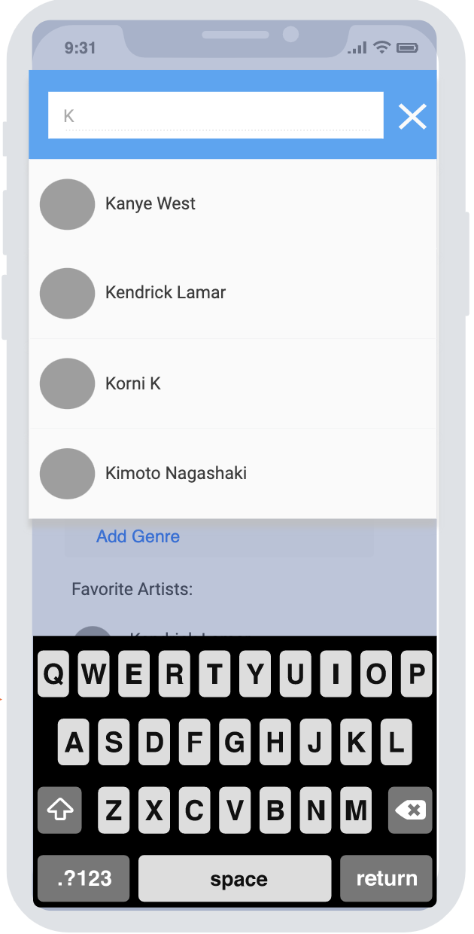
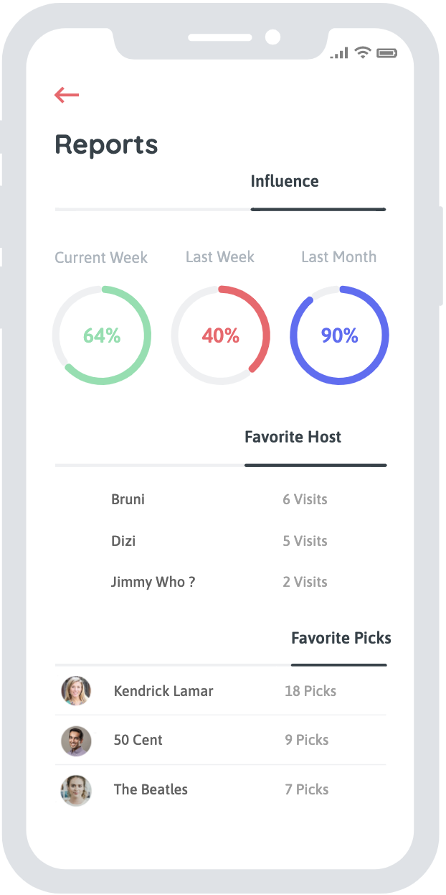
Plus:
Adding Artists
History Reports
And More..

Slide 11
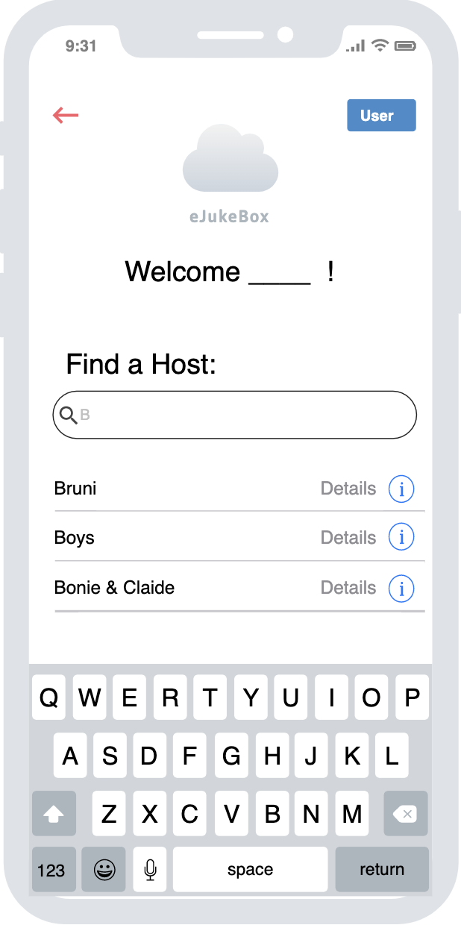
You’ve been identified. Now, lets find a host -
The host is the owner of the virtual Juke box (aka eJukeBox).
Users can look for a host by name or by location

Slide 12
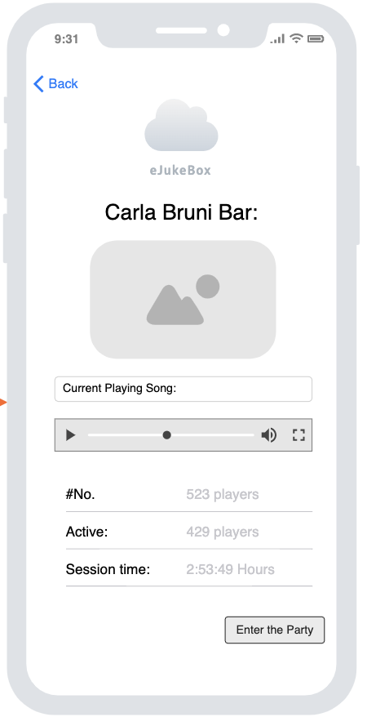
You found your host. Host page Includes:
Current song being played
Users joined so far
Total Listeners
Session Time
Now you just need to ‘Enter the Party’

Slide 13
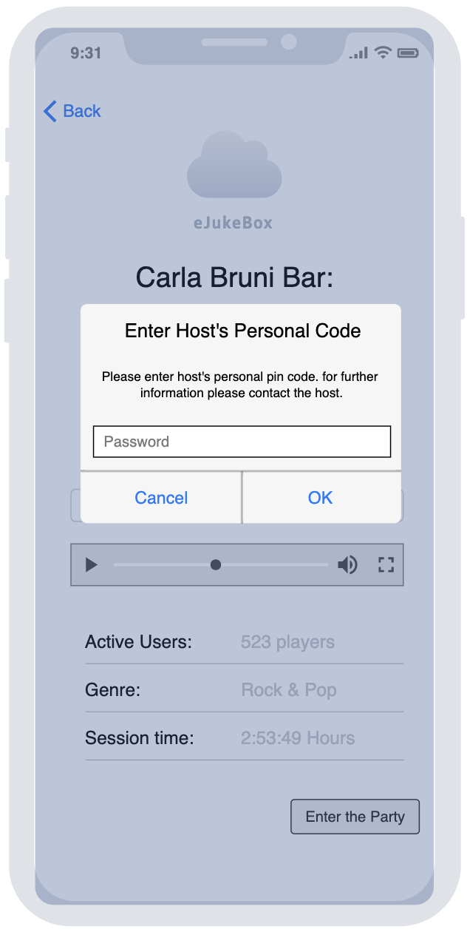
Host Pin CODE
The host would physically hand out the pin /QR code to his clients. This mechanism will ensure that joiners are physically present in the venue.

Slide 14
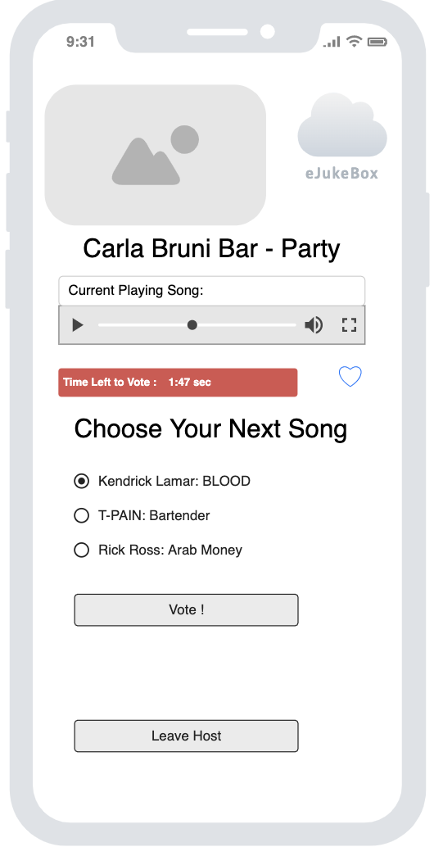
Congratiolations! You entered the party
See what’s being played right now.
See the time left for “next song voting”.
Vote for the next song you want everyone to listen to.
Leave the party and join another host.
Registered users could “Like and Save” favorites songs.
Registered users could participate in extra activities.
Like

Slide 15
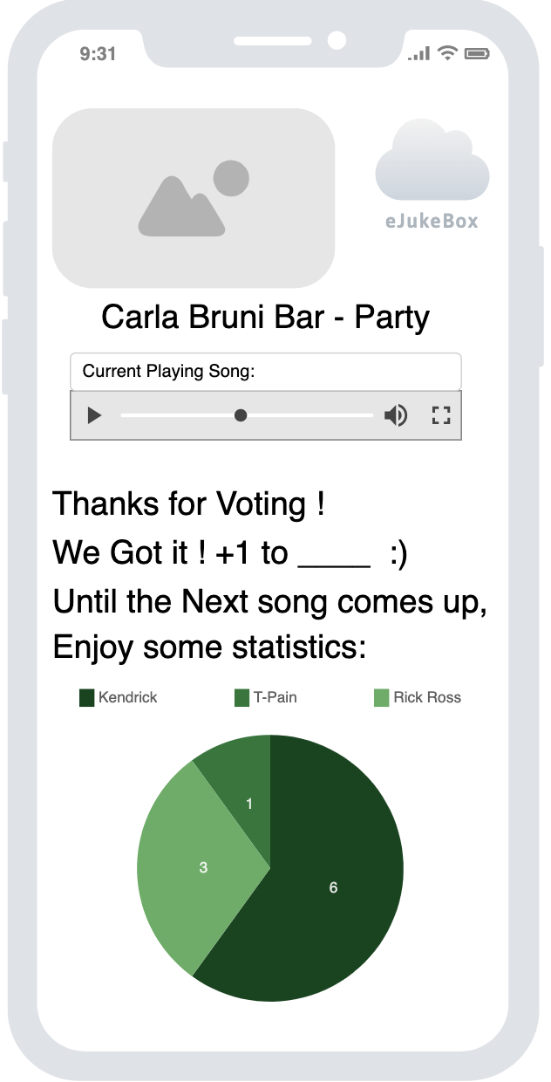
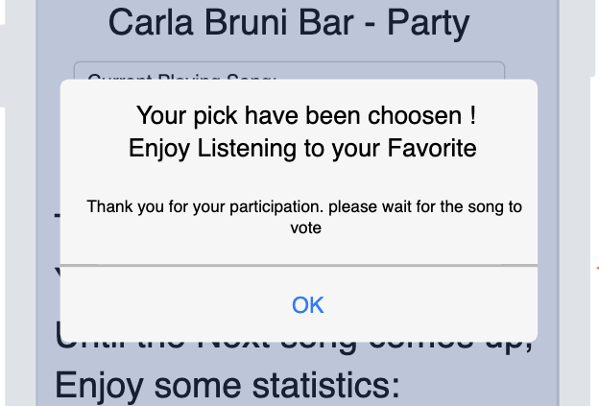
After Voting
See votes statistics and a thank you confirmation.
When its time for voting again (for the next song) you will be notified and redirected back

Slide 16

So That’s It. The whole user experience. many more features to come

Slide 17
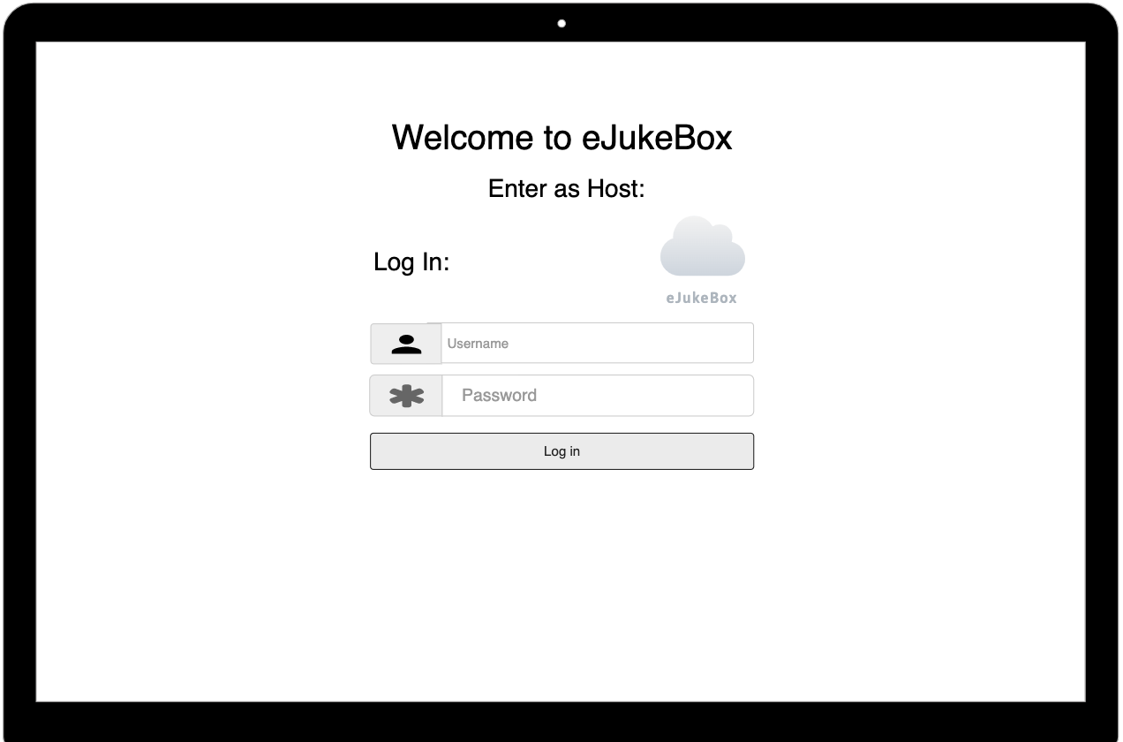
Host – Log in Page
Log in as a host via Member Subscription
Cannot Sign up

Slide 18
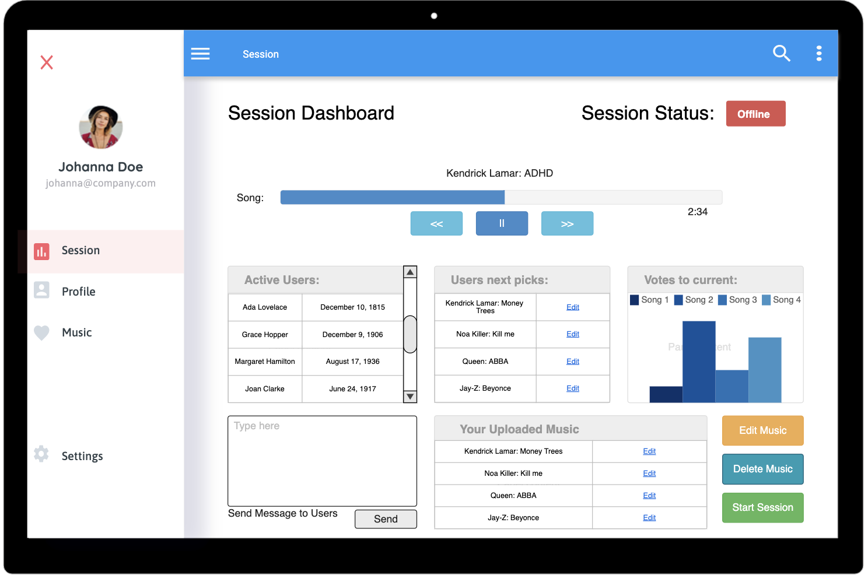
Host – Dashboard
Current Song playing
Active Users
Edit next Picks
See Current Voting
Manage Music
Send Users a message
Start/Stop Session
And More to come…

Slide 19
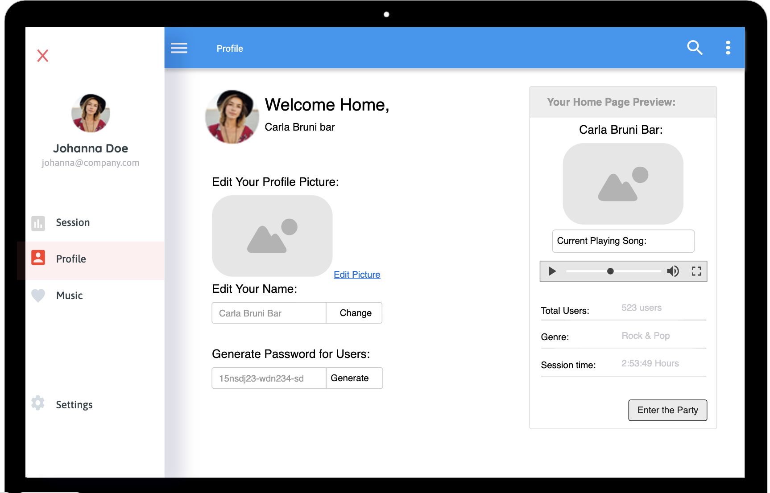
Host – Profile
Manage your personal data.
Change profile pic
Change profile name
Generate a password for your session.

Slide 20
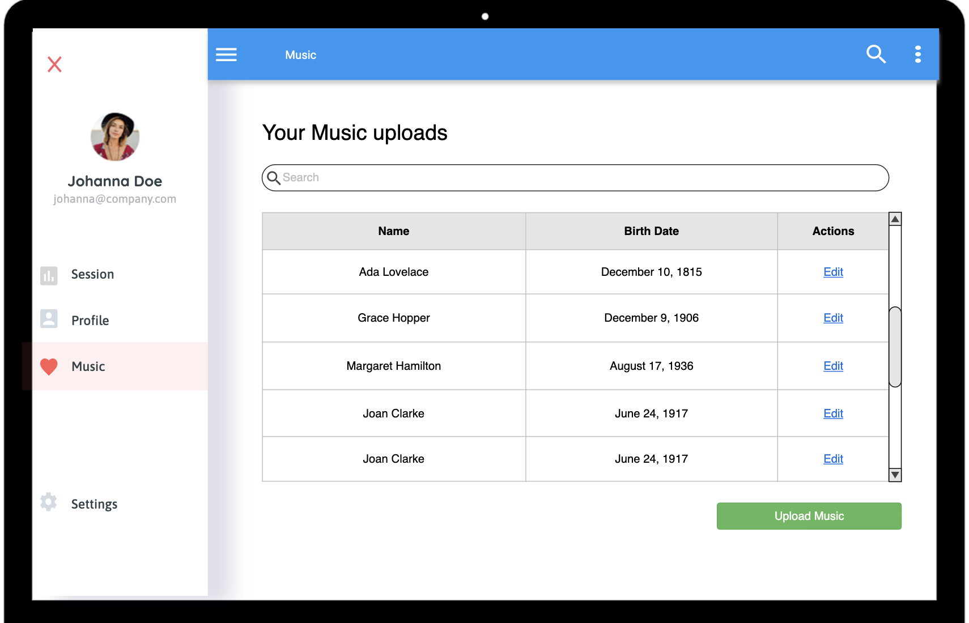
Music - Dashboard
Search for music you have uploaded
Manage music you have uploaded
Delete/Add Music
And more to come…

